Slide 1
Verified Caller API
China Telecom

Slide 2
Contents
Verified Caller Architechture
Service API
Verified Message
Network API

Slide 3
Verified Caller Architecture
Customer
Service API
Open Gateway
Network API
IMS Message AS
MO
SS
MT
P-CSCF
I-CSCF
S-CSCF
S-CSCF
HSS
P-CSCF
AS
IMS
Notes:
主叫签约iFC

Slide 4
Technical Viability
-Service API
Customer
1-2. Enter the basic customer information
(customer name, number, address and contact phone numbers)
①
Open Gateway
3. Submit qualifications of the customer
(proof of authorized relationship between the customer and the number, business license, content of the verified message /video)
②
Audit Platform
③
4. Return the audit results
CRM
④
5. Subscribe
(customer number signaling)
⑤
IMS Core
IMS

Slide 5
Network API
Verified Message
MDS
Customer
Ordering the service
Network API
Open Gateway
IMS Message
AS
User subscription
Response
Calling
IMS Pool
Calling status report
Continue on calling
Response
Ringing
Matching verified message templates, verified message content, black and gray lists, grouping strategies
Invoking verified message

Slide 6
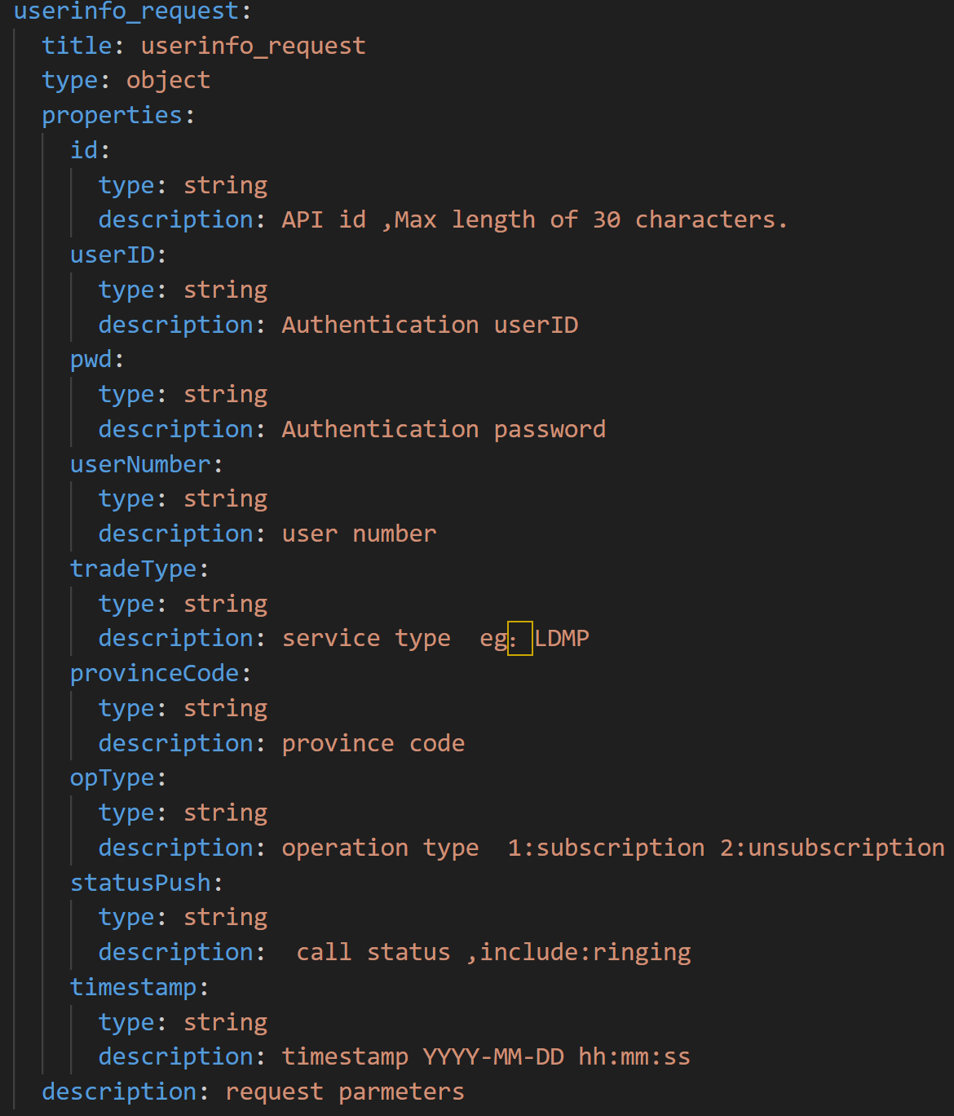
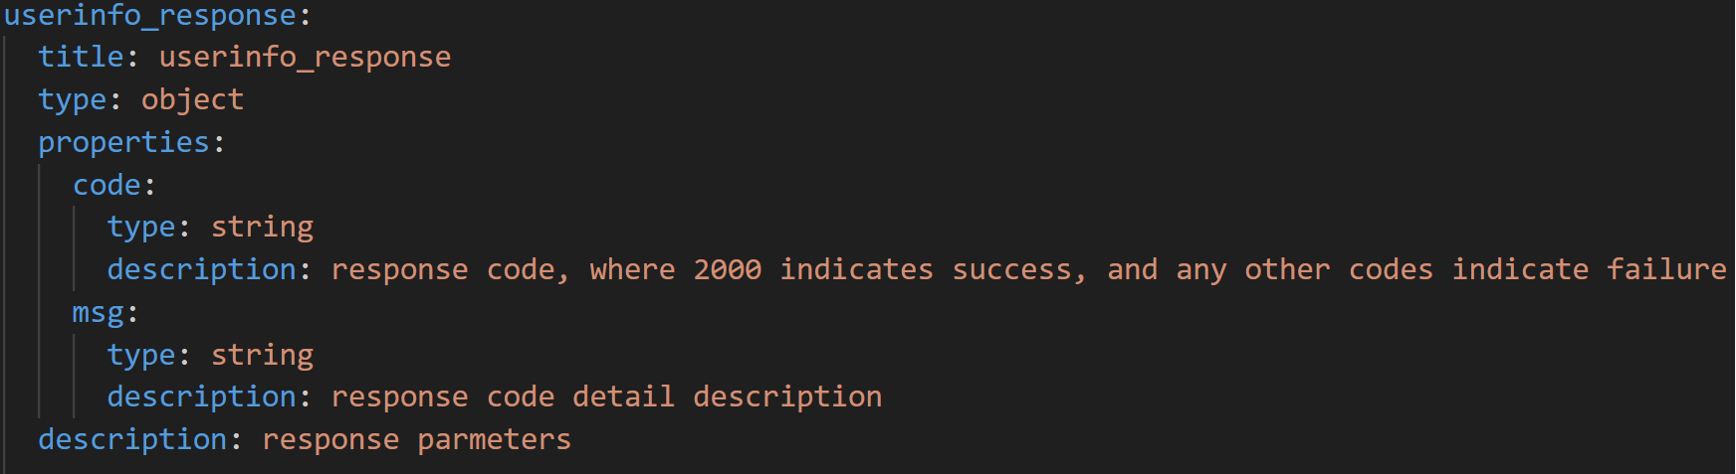
Network API
Subscription
IMS Message AS
User subscription
Response
Open Gateway

Slide 7
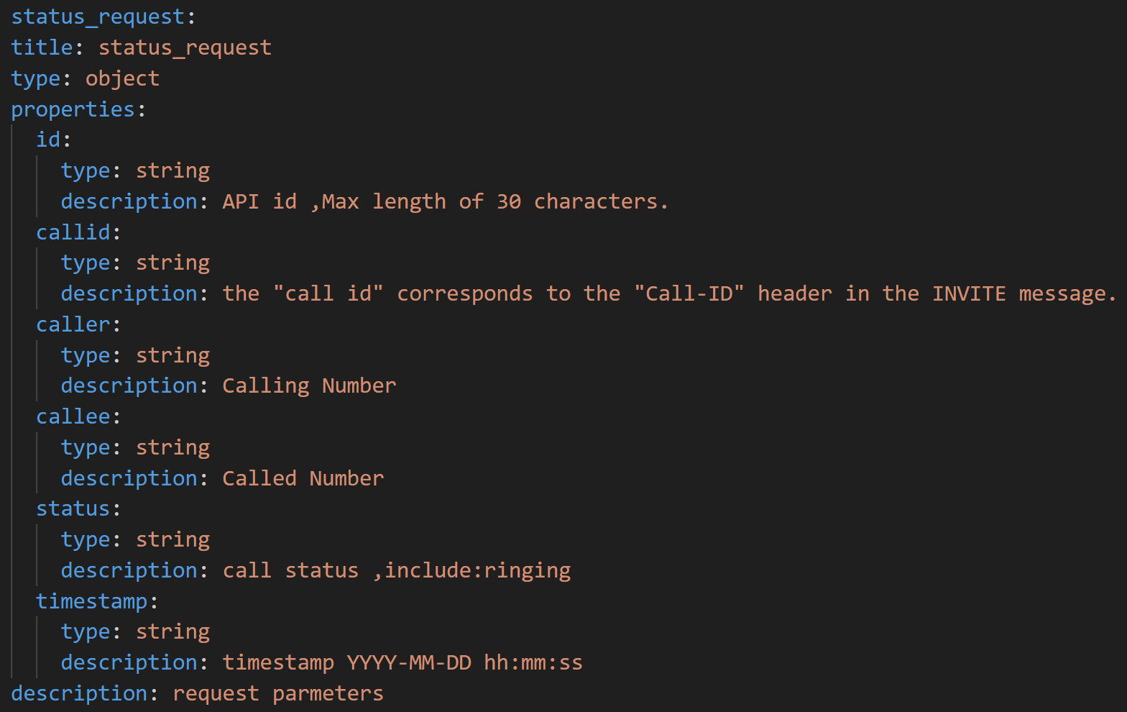
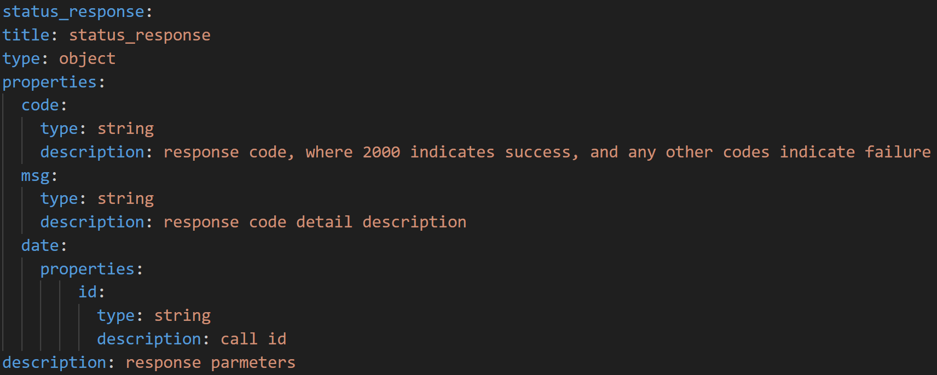
Network API
Calling Status Report
Open Gateway
Calling status report
Response
IMS Message AS

Slide 8
Thank you

